Slide 1



PROJECT ON
TELANGANA WEATHER ANALYSICS USING POWER BI
Presented by: S. Rithin Reddy
BATCH.No: 450
Subject: POWER BI
Branch: Dilsukhnagar

Slide 2
Agenda
Business Problem
Objective
Dataset Overview
Data Preparation & Cleaning
Dashboard Visualizations
Applications & Recommendations
Conclusion & Future Scope

Slide 3
Business Problem
Weather patterns in Telangana vary widely across districts and mandals due to geographical and seasonal factors. However, raw weather data is scattered and complex, making it difficult to identify trends in rainfall, temperature, humidity, and wind speed. This limits effective decision-making in agriculture, disaster management, and climate planning. Hence, there is a need for an interactive analytical system to visualize and analyze weather data efficiently.

Slide 4
Objective
To analyze weather patterns in Telangana State.
To understand rainfall, temperature, wind and humidity trends.
To compare district-wise and mandal-wise variations.
To create interactive dashboards for better insights.
To support agriculture planning and climate understanding.

Slide 5
Dataset Overview
Dataset Name: Telangana State Weather Dataset
Source: CSV files (Monthly data)
File Type: CSV
Years Covered: 2021 – 2024
Granularity: District & Mandal level
Key Columns:
  District
  Mandal
  Date
  Rainfall (mm)
  Min & Max Temperature (°C)
  Min & Max Humidity (%)
  Min & Max Wind Speed (Kmph)

Slide 6
Data Preparation & Cleaning
Imported multiple CSV files into Power BI
Removed unwanted Excel files to avoid errors
Standardized column names
Converted Date column into proper date format
Created calculated measures:
Average Rainfall
Average Min & Max Temperature
Temperature Range (Max – Min)
Handled missing and inconsistent values

Slide 7
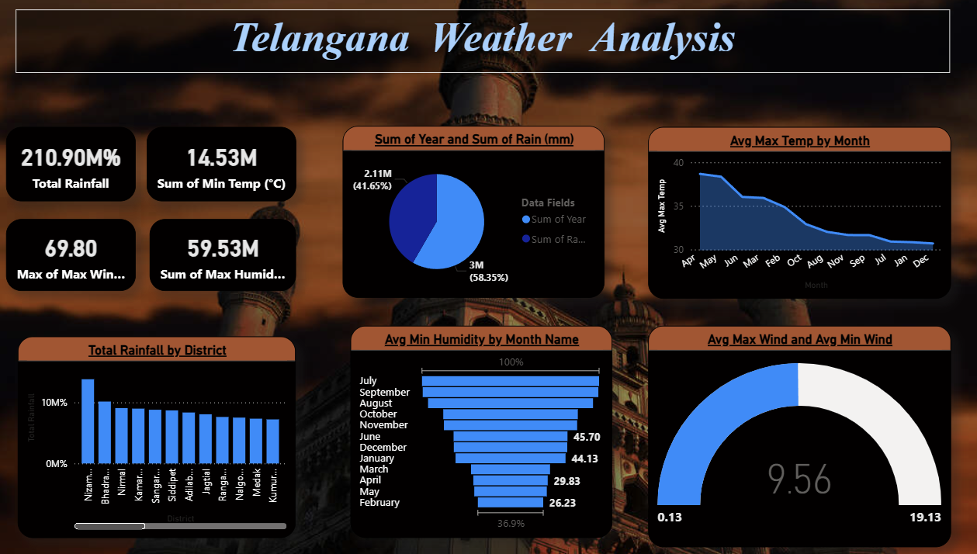

Slide 8
Dashboard Visualizations
1. TS WEATHER REPORT (OVERVIEW DASHBOARD)
Visuals Used:
KPI Cards: Total Rainfall, Sum of Minimum Temperature, Maximum Wind Speed, Sum of Maximum Humidity
Pie Chart → Contribution of Rainfall across Years
Line Chart → Average Maximum Temperature by Month
Column Chart → Total Rainfall by District
Funnel Chart → Average Minimum Humidity by Month
Gauge Chart → Average Maximum Wind Speed and Minimum Wind Speed
Purpose:
To provide a high-level summary of Telangana’s overall weather conditions, enabling quick comparison of rainfall, temperature, humidity, and wind speed patterns across districts and months.

Slide 9
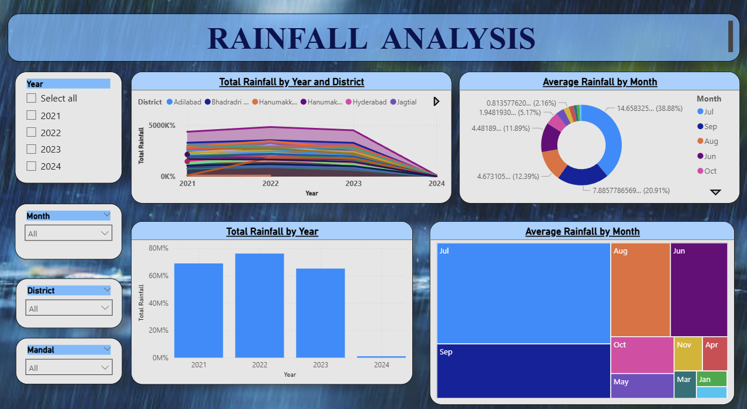

Slide 10
2. RAINFALL ANALYSIS
Visuals Used:
Slicers → Year, Month, District, Mandal
Line Chart → Total Rainfall by Year and District
Donut Chart → Average Rainfall Contribution by Month
Stacked Column Chart→ Comparison of Year and Total Rainfall
Treemap→ Average Rainfall by Month
Purpose:
To analyze rainfall distribution across years, identify seasonal rainfall trends, compare district-wise rainfall, and highlight mandals experiencing high or low rainfall intensity.

Slide 11
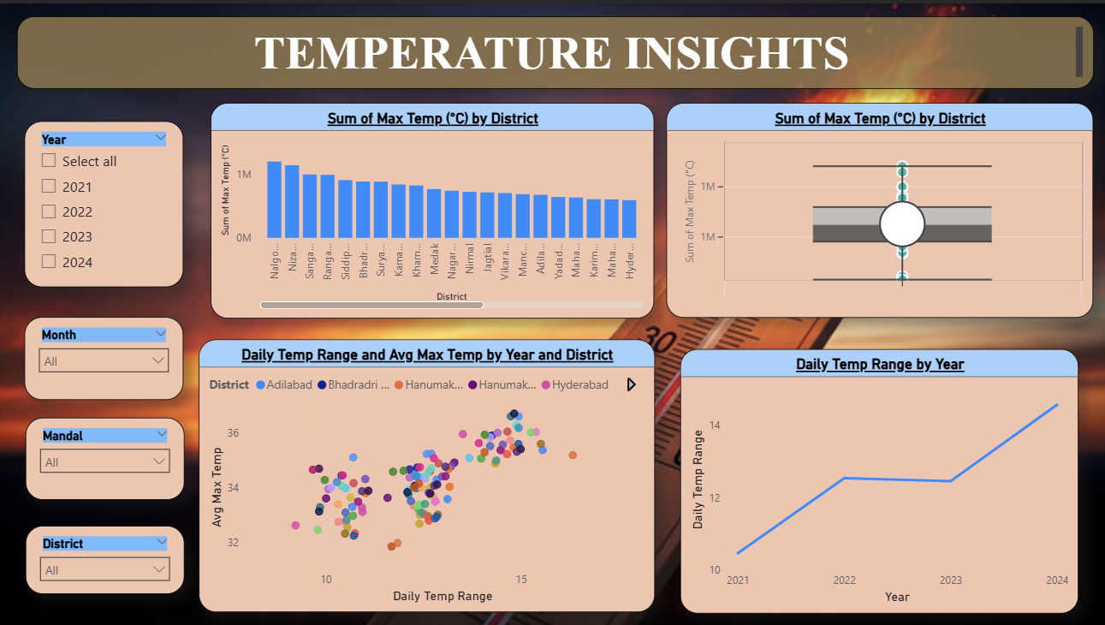

Slide 12
3. Temperature Insights
Visuals Used:
Slicers → Year, Month, District, Mandal
Line Chart → Average Minimum and Maximum Temperature by Year
Scatter Plot→ Relationship between Daily Temperature and Avgerage Maximum Temperature By District
Box Plot→ Distribution and outliers of Maximum Temperature
Column Chart→ Temperature Range By Year
Purpose:
To understand temperature variation across districts, analyze long-term temperature trends, identify extreme temperature conditions, and examine the correlation between temperature and rainfall.

Slide 13
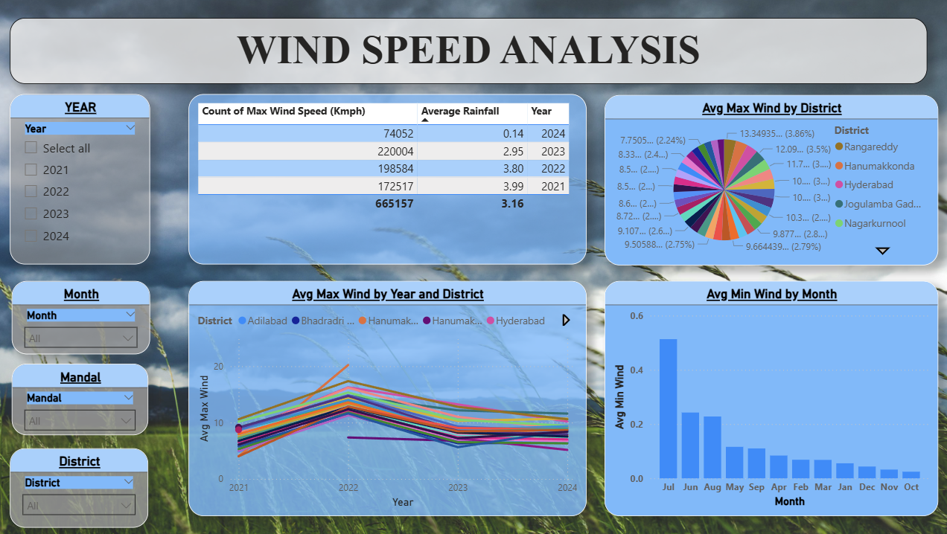

Slide 14
4. Wind Speed Analysis
Visuals Used:
Slicers → Year, Month, District, Mandal
Table→ Year-wise Count of Maximum Wind Speed and Average Rainfall
Pie Chart→ Distribution of AVG Max Wind by District
Line Chart→ Average Maximum and Minimum Wind Speed by Year
Column Chart→ Average Minimum Wind Speed by Month
Purpose:
To analyze wind speed behavior across years and districts, detect extreme wind events, identify seasonal wind patterns, and assess how wind speed varies throughout the year.

Slide 15
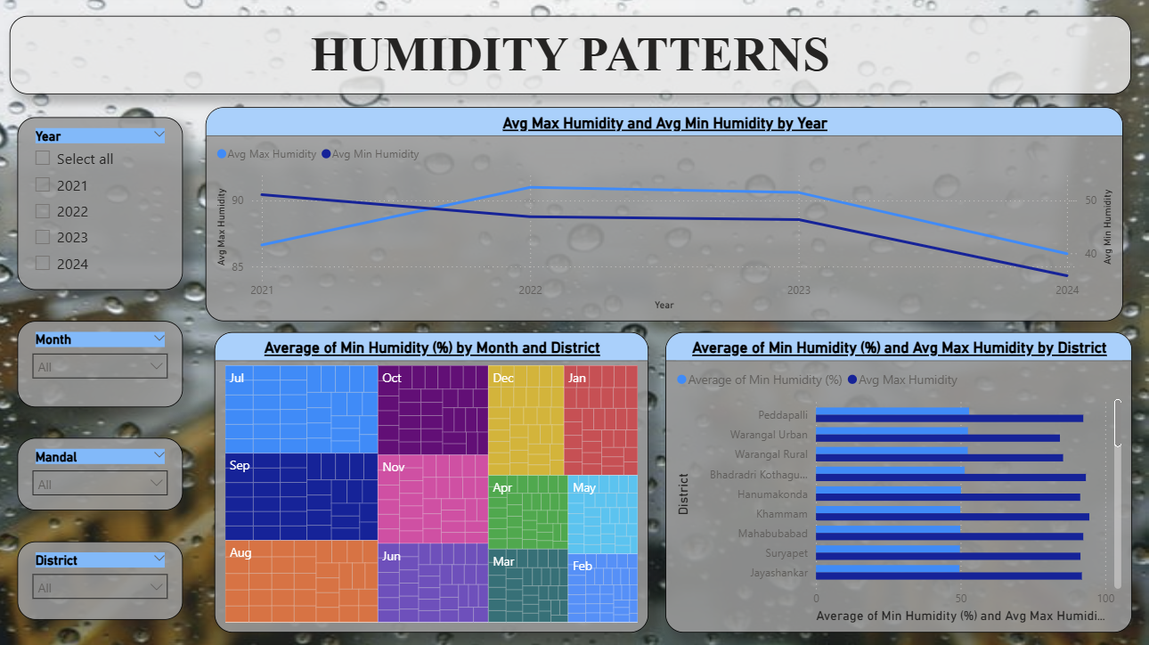

Slide 16
5. Humidity Patterns
Visuals Used:
Slicers → Year, Month, District, Mandal
Bar Chart→ Average Minimum and Maximum Humidity by District
Line Chart→ Average Humidity Trends by Year.
Treemap→ Average Minimum Humidity by Month and District
Purpose:
To study humidity variations across seasons and districts, identify regions with high or low humidity levels, and analyze long-term humidity trends impacting climate and comfort conditions.

Slide 17
Applications & Recommendations
Applications
Helps farmers plan crops based on rainfall patterns
Useful for government disaster management
Supports climate change analysis
Assists water resource planning
Can be used in weather forecasting models
Recommendations
Focus flood preparedness in high rainfall districts
Plan water storage based on seasonal rainfall trends
Implement heat mitigation strategies in high-temperature regions
Monitor extreme humidity and wind conditions for public safety

Slide 18
Conclusion & Future Scope:
Conclusion:
Power BI enables effective visualization of complex weather data
District-wise analysis provides valuable regional insights
Future Enhancements:
Add more years of data for trend analysis
Integrate real-time weather APIs
Predict rainfall and temperature using ML models
Create mobile-friendly dashboards

Slide 19

THANK YOU

